Slide 1
Trees
EECE Department
ELC 303-B
Dr. Ahmed Khattab

Slide 2
Overview
Trees are a flexible data structure useful for solving a wide range of problems.
Trees represent data in a hierarchical manner, not linear
Binary search trees allow rapid retrieval by key, plus in-order processing.
Recursion is used frequently

Slide 3
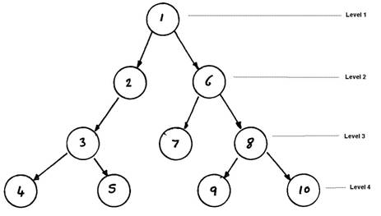
A Tree
Node - tree element
Root - the node at the top
Parent/child nodes
Degree - number of child nodes
Subtree
Siblings - have the same parent
Ancestor/ Descendant
Leaves - nodes without children
Internal nodes - nodes with children
Edge/branch/link/arc: connection between one node and another
Path: sequence of edges from root to node
Length of the path: number of edges in the path
Depth of a node: length of path from root to node
Levels: 1 + the number of edges between the node the root.
Height – maximum level of a node in a tree

Slide 4
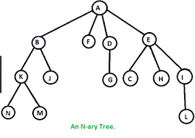
A Binary Tree vs. N-ary tree
A
B
C
D
E
F
G
H
I
J
K
L
M
N

Slide 5
Binary Tree Definition
A binary tree is either:
1. an empty tree; or
2. consists of a node, called a root, and two children, left and right, each of which are themselves binary trees.

Slide 6
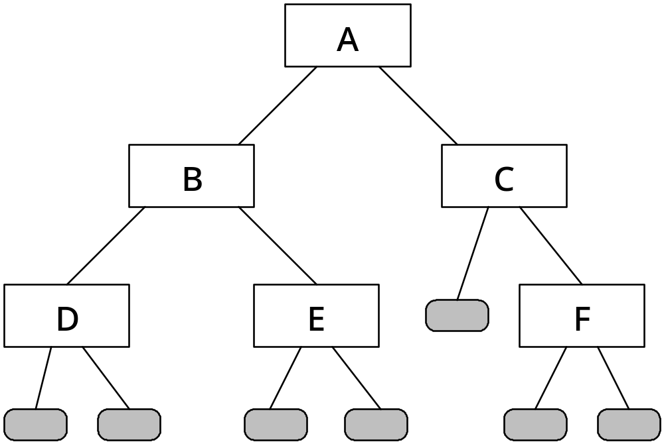
A Binary Tree

Slide 7
Expression Trees
3+7*2-1
3+(7*2)-1 grouping for * precedence
(3+(7*2))-1 left->right associative + vs. -

Slide 8
Expression tree for 3 + 7 * 2 - 1
-
+
1
3
X
7
2

Slide 9
Expression Tree After First Subtree Eliminated
−
+
1
3
14

Slide 10
Expression Tree After Second Subtree Eliminated
−
17
1

Slide 11
Final Value of Expression Tree
16

Slide 12
Implementing Binary Trees
Two methods:
1. Linear representation - array
2. Linked representation - pointers

Slide 13
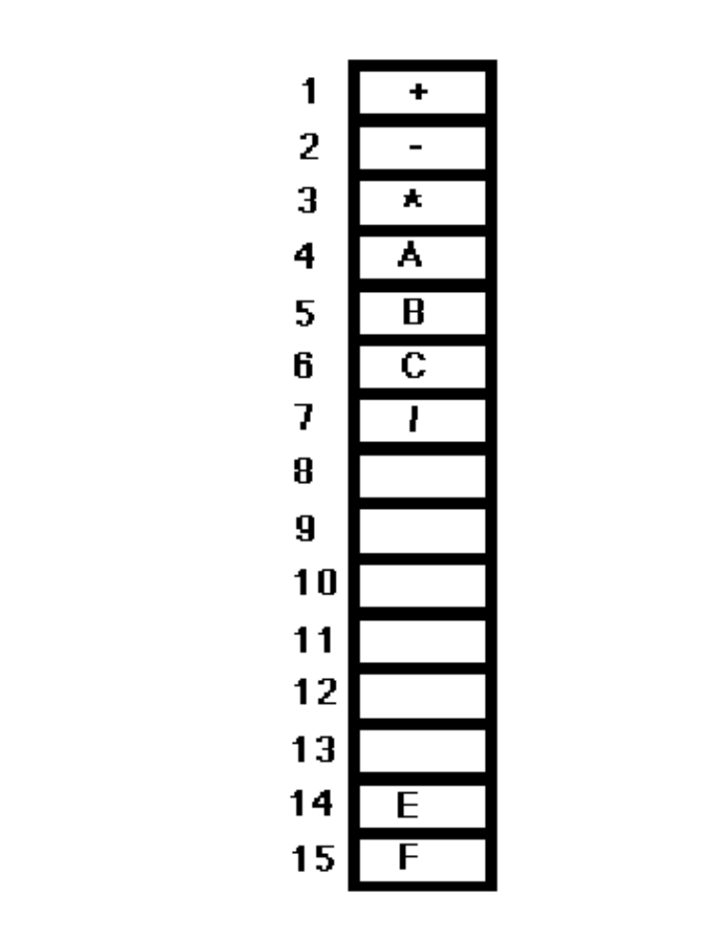
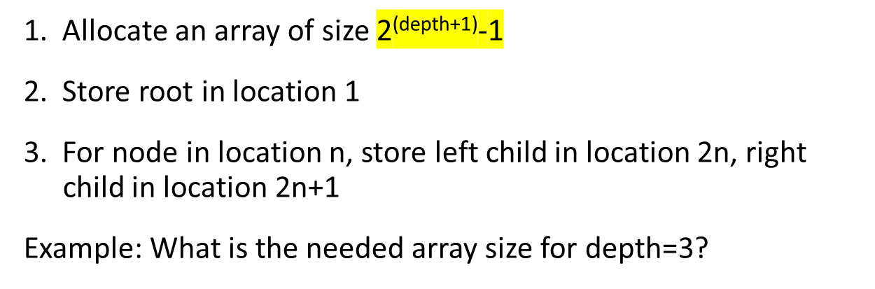
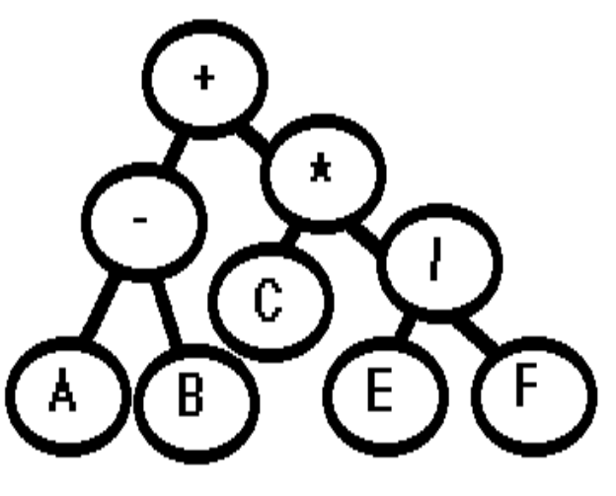
BT Linear representation

Slide 14
Tradeoffs
Fast access (given a node, its children and parent can be found very quickly)
Slow updates (inserts and deletions require physical reordering)
Wasted space (partially filled trees)

Slide 15
Binary Tree ADT
Characteristics
  A Binary Tree ADT T stores data of some type (btElementType)
Operations
  isEmpty
  getData
  insert
  left
  right
  makeLeft
  makeRight

Slide 16
Binary Tree Header File
template < class btElementType >
class BinaryTree {
public:
BinaryTree();
bool isEmpty() const;
// Precondition: None.
// Postcondition: None.
// Returns: true if and only if T is an empty tree

Slide 17
getData( ), insert( )
btElementType getData() const;
// getData is an accessor
// Precondition: !this->isEmpty()
// Postcondition: None
// Returns: data associated with the root of the tree
void insert(const btElementType & d);
// Precondition: none
// Postconditions: this->getData() == d; !this->isEmpty()

Slide 18
left( ) and right( )
BinaryTree * left();
// Precondition: !this->isEmpty()
// Postcondition: None
// Returns: (a pointer to) the left child of T
BinaryTree * right();
// Precondition: !this->isEmpty()
// Postcondition: None
// Returns: (a pointer to) the right child of T

Slide 19
makeLeft( ), makeRight( )
void makeLeft(BinaryTree * T1);
// Precondition: !this->isEmpty(); this->left()->isEmpty()
// Postcondition: this->left() == T1
void makeRight(BinaryTree * T1);
// Precondition: !this->isEmpty(); this->right()->isEmpty()
// Postcondition: this->right() == T1

Slide 20
Private Section
private:
bool nullTree;
btElementType treeData;
BinaryTree * leftTree;
BinaryTree * rightTree;
};
nullTree { f/t}
data
left
right

Slide 21
Implementation file: Constructor
template < class btElementType >
BinaryTree < btElementType > :: BinaryTree()
{
nullTree = true;
leftTree = NULL;
rightTree = NULL;
}

Slide 22
isEmpty( )
template < class btElementType >
bool
BinaryTree < btElementType > :: isEmpty() const
{
return nullTree;
}

Slide 23
getData( )
template < class btElementType >
btElementType
BinaryTree < btElementType > :: getData() const
{
assert(!isEmpty());
return treeData;
}

Slide 24
insert( )
template < class btElementType >
void BinaryTree < btElementType >
:: insert(const btElementType & d)
{
treeData = d;
if (nullTree) {
nullTree = false;
leftTree = new BinaryTree;
rightTree = new BinaryTree;
} }

Slide 25
left( )
template < class btElementType >
BinaryTree < btElementType > *
BinaryTree < btElementType > :: left()
{
assert(!isEmpty());
return leftTree;
}

Slide 26
right( )
template < class btElementType >
BinaryTree < btElementType > *
BinaryTree < btElementType > :: right()
{
assert(!isEmpty());
return rightTree;
}

Slide 27
makeLeft( )
template < class btElementType >
void BinaryTree < btElementType >
:: makeLeft(BinaryTree * T1)
{
assert(!isEmpty());
assert(left()->isEmpty());
delete left(); // could be nullTree true, w/data
leftTree = T1;
}

Slide 28
makeRight( )
template < class btElementType >
void BinaryTree < btElementType >
:: makeRight(BinaryTree * T1)
{
assert(!isEmpty());
assert(right()->isEmpty());
delete right();
rightTree = T1;
}

Slide 29
The Operation of Client Code Example
bt6
A
bt3
B
bt5
C
bt1
D
bt2
E
bt4
F

Slide 30
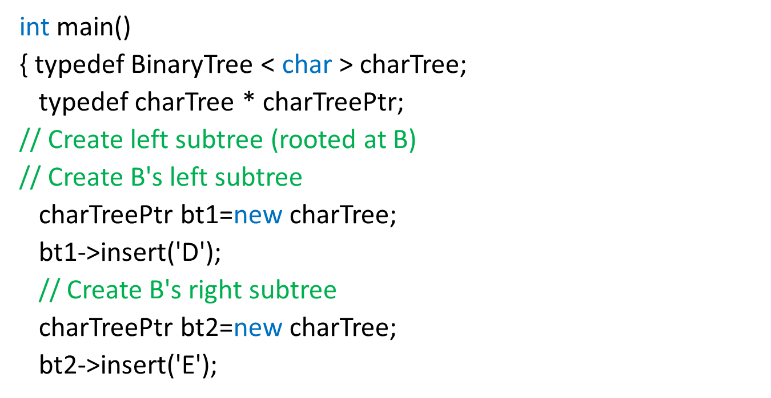
Simple Client for Binary Tree
D
bt1
E
bt2

Slide 31
Create Tree
// Create node containing B, and link
// up to subtrees
charTreePtr bt3=new charTree;
bt3->insert('B');
bt3->makeLeft(bt1);
bt3->makeRight(bt2);
// ** done creating left subtree
bt3
B
bt1
bt2
D
E

Slide 32
Create Right Subtree
// Create C's right subtree
charTreePtr bt4=new charTree;
bt4->insert('F');
// Create node containing C, and link
// up its right subtree
charTreePtr bt5=new charTree;
bt5->insert('C');
bt5->makeRight(bt4);
// ** done creating right subtree
bt5
C
F
bt4

Slide 33
Create the Root of the Tree
charTreePtr bt6(new charTree);
bt6->insert('A');
bt6->makeLeft(bt3);
bt6->makeRight(bt5);
// print out the root
cout << "Root contains: " << bt6->getData() << endl;

Slide 34
Final Product
bt6
A
bt3
B
bt5
C
bt1
D
bt2
E
bt4
F

Slide 35
Print Left and Right Subtrees
// print out root of left subtree
cout << "Left subtree root: " << bt6->left()->getData() << endl;
// print out root of right subtree
cout << "Right subtree root: " << bt6->right()->getData() << endl;

Slide 36
Print Extreme Child Nodes
cout << "Leftmost child is: " <<
bt6->left()->left()->getData() << endl;
cout << "Rightmost child is: " <<
bt6->right()->right()->getData() << endl;
return 0;
}

Slide 37
Methods of Tree Traversal
Must visit every element once
Must not miss any
Three basic types
  preorder
  inorder
  postorder

Slide 38
Preorder Traversal
if the tree is not empty
visit the root
preOrderTraverse(left child)
preOrderTraverse(right child)

Slide 39
Inorder traversal
if the tree is not empty
inOrderTraverse(left child)
visit the root
inOrderTraverse(right child)

Slide 40
Postorder traversal
if the tree is not empty
postOrderTraverse(left child)
postOrderTraverse(right child)
visit the root

Slide 41
Sample Tree to Illustrate Tree Traversal
1
2
3
4
5
6
7
8
9
10
11
12

Slide 42
Tree after Four Nodes Visited in Preorder Traversal
1
1
2
2
3
3
4
5
6
7
4
8
9
10
11
12

Slide 43
Tree after Left Subtree Visited Using Preorder Traversal
1
1
2
2
3
3
4
6
5
6
7
4
8
9
5
7
10
11
12

Slide 44
Tree after Completed Preorder Traversal
1
1
2
2
8
3
3
4
6
5
9
6
12
7
4
8
9
5
7
10
10
11
12
11

Slide 45
Tree visited using inorder traversal
7
1
4
2
11
3
2
4
5
5
9
6
12
7
1
8
9
3
6
10
8
11
12
10

Slide 46
Tree visited using postorder Traversal
12
1
6
2
11
3
3
4
5
5
9
6
10
7
1
8
9
2
4
10
7
11
12
8

Slide 47
Expression Tree for
3 + 7 *2 - 1
−
+
1
3
14

Slide 48
Binary Tree Traversals: preorder
typedef BinaryTree < int > btint;
typedef btint * btintp;
void preOrderTraverse(btintp bt)
{ if (!bt->isEmpty()) { // if not empty
// visit tree
cout << bt->getData() << '\t';
// traverse left child
preOrderTraverse(bt->left());
// traverse right child
preOrderTraverse(bt->right());
}
}

Slide 49
Inorder traversal
void inOrderTraverse(btintp bt)
{
if (!bt->isEmpty()) {
// traverse left child
inOrderTraverse(bt->left());
// visit tree
cout << bt->getData() << '\t';
// traverse right child
inOrderTraverse(bt->right());
}
}

Slide 50
For the following tree, answer the following
1) The number of internal nodes in the tree are
a) 2 b) 8 c) 6 d) none of the above
2) The height of the tree is
a) 4 b) 3 c) 2 d) none of the above
3) If a postorder traverse is used, what is the order of accessing the root?
a) 1 b) 14 c) 3 d) none of the above
4) Is B node considered a tree?
a)True b) False
5) If a preorder traverse is used,
what is the order of accessing the root?
a) 1 b) 14 c) 3 d) none of the above

Slide 51
A Binary Search Tree
17
10
26
6
14
20
34
11
31
37

Slide 52
An Ordered Tree ADT
BSTs are ordered
BSTs provide for fast retrieval and insertion
BSTs also support sequential processing of elements

Slide 53
Definition of BST
A Binary Search Tree (BST) is either
1. An empty tree, or
2. A tree consisting of a node, called the root, and two children called left and right, each of which is also a BST. Each node contains a value such that the root is greater than all node values stored in its left subtree and less than all values stored in the right subtree.
The BST invariant
  The invariant is the ordering property
  “less than goes left, greater than goes right.”

Slide 54
Not a BST: invariant is violated
17
10
26
6
14
15
34
11
31
37

Slide 55
Not a BST: subtree is not a BST
17
10
26
6
14
20
28
11
31
37

Slide 56
Binary Search Tree ADT
Characteristics
A Binary Search Tree ADT T
stores data of some type (btElementType)
Obeys definition of BST (see earlier slide)
Prerequisites
The data type btElementType must
implement the < and == operators. (operator overloading)

Slide 57
BST ADT Operations
isEmpty() // check for empty BST
getData() // accessor
insert() // inserts new node
retrieve() // returns pointer to a BST
left() // returns left child
right() // returns right child

Slide 58
Where 12 would be inserted
17
10
26
6
14
20
31
11
28
37

Slide 59
After 12 inserted
17
10
26
6
14
20
28
11
31
37
12

Slide 60
insert( )
template < class btElementType >
void BST < btElementType >
:: insert(const btElementType & d)
{
if (nullTree) {
nullTree = false;
leftTree = new BST;
rightTree = new BST;
treeData = d;
}
nullTree
true false
treeData
d
left
right
0
0

Slide 61
insert (if not empty)
else if (d == treeData) ; // do nothing -- it's already here!
else if (d < treeData)
leftTree->insert(d); // insert in left subtree
else
rightTree->insert(d); // insert in right subtree
}

Slide 62
retrieve( )
BinaryTree T.retrieve(btElementType d)
Precondition: T meets the BST invariant.
Postcondition: T meets the BST invariant.
Returns: if T contains a node with data d, then T.retrieve(d).getData() == d; otherwise, T.retrieve(d).isEmpty().

Slide 63
retrieve( )
template < class btElementType > BST < btElementType > *
BST < btElementType > :: retrieve(const btElementType & d)
{
if (nullTree || d == treeData)
// return pointer to tree for which retrieve was called
return this;
else if (d < treeData)
return leftTree->retrieve(d); // recurse left
else
return rightTree->retrieve(d); // recurse right
}

Slide 64
Client of BST
int main()
{
typedef BST < int > intBST;
typedef intBST * intBSTPtr;
intBSTPtr b(new intBST);
b->insert(17); b->insert(10); b->insert(26);
b->insert(6); b->insert(14); b->insert(20);
b->insert(28); b->insert(11); b->insert(31);
b->insert(37); b->insert(12);

Slide 65
BST Result
17
10
26
6
14
20
28
11
31
37
12

Slide 66
Retrieval
// is 11 in the tree?
intBSTPtr get11(b->retrieve(11));
if (get11->isEmpty())
cout << "11 not found.\n";
else cout << "11 found.\n";
// is 13 in the tree?
intBSTPtr get13(b->retrieve(13));
if (get13->isEmpty())
cout << "13 not found.\n";
else cout << "13 found.\n";
return 0;
}

Slide 67
17
10
26
6
14
20
28
11 found
11
31
37
12
13 not found

Slide 68
Reuse through Inheritance
Important OOP language features
Encapsulation: for abstractions like classes, types, objects.
Inheritance: abstractions can be reused
Polymorphism: statements that use more than one abstraction, with the language choosing the right one while the program is running.

Slide 69
“is-a” Relations
Defining one abstraction in terms of another.
The Binary Tree ADT is a general class of which binary search trees are one type.
Therefore, if we define a Binary Tree ADT we should be able to define a BST as a special case which inherits the characteristics of the Binary Tree ADT.
A BST “is a” Binary Tree, with special features
So, the BST is a derived class of the Binary Tree base class

Slide 70
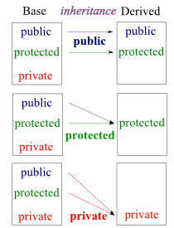
Inheritance Terminology
Base class - the one from which others inherit
Derived class - one which inherits from others
So, the BST is a derived class of the Binary Tree base class.

Slide 71
Inheritance Diagram
BinaryTree
BST

Slide 72
Implementing inheritance in C++
Base classes are designed so that they can be inherited from.
One crucial aspect of inheritance is that the derived class may wish to implement member functions of the base case a little differently.
Good examples are insertion for BST (which must follow the ordering principle) and constructors.

Slide 73
Protected Members
We have used public and private sections of our class definitions. There is also ‘protected’.
Protected means that the members are hidden from access (private) for everything except derived classes, which have public access rights.
Derived classes can use the data members of base classes directly, without accessors

Slide 74
Public Inheritance
Inheritance notation is done like this
class BST : public BinaryTree
public means that BST client code must be able to access the public members of the base class. (public inheritance)
It means that derived functions will only redefine member functions that they must (like insert() for BST). All other functions will be the public ones in the base class.

Slide 75
BST Inherited Class
template < class btElementType >
class BST : public BinaryTree < btElementType > {
public:
BST();
void insert(const btElementType & d);
BinaryTree < btElementType > * retrieve(const btElementType & d);
};

Slide 76
Why so short?
The BST derived class definition was so short because it only needed to declare member functions that represented changes from the public functions of the base class.
All other functions come from the already defined base class.

Slide 77
Binary Tree Base Class
public:
BinaryTree()
insert()
Private:
nullTree
isEmpty()
left()
makeLeft()
treeData
getData()
right()
makeRight()
leftTree
rightTree
BST Derived Class
public:
BST()
insert()
retrieve()

Slide 78
Derived class constructors
To construct a BST we must first call the Binary Tree constructor (the base class)
Once this has been called, then the body of the BST constructor can add additional things on to it.
In this case, we have nothing to add (see next slide)

Slide 79
Constructor (inheritance)
template < class btElementType >
BST < btElementType >
:: BST() : BinaryTree < btElementType >()
{
}

Slide 80
Chapter Summary
Tree represent data in a hierarchical manner.
In a Binary Tree, each node has a left and a right child.
Expression Trees are a Binary Tree that can represent arithmetic expressions.
The data in a tree can be visited using in-order, pre-order, and post-order traversals.
Function pointers can be used to pass one function to another as an argument.
The Binary Search Tree is an ordered tree ADT.

Slide 81
Chapter Summary
Binary Search Trees support efficient retrieval by key
Inheritance can be used to model is-a relations.
Inheritance can be implemented in C++ through base and derived classes.
Inheritance supports code reuse.
Binary Search Tree can have bad performance if they’re unbalanced, but very good performance when balanced.

Slide 82
Using Function Pointers
We are used to sending pointers to variables
Anything that has an address has a pointer
Functions are addressable
Therefore we can send functions into other functions by sending in their pointers
Similarly, we can call functions by dereferencing these pointers

Slide 83
Visit function
void visit(btintp bt)
{
cout << bt->getData() << '\t';
}

Slide 84
preorder traversal w/ *
typedef BinaryTree < int > btint;
typedef btint * btintp; // pointer to integer binary tree
void preOrderTraverse(btintp bt, void visit(btintp))
{ if (!bt->isEmpty()) {
(* visit)(bt); // visit tree
// traverse left child
preOrderTraverse(bt->left(), visit);
// traverse right child
preOrderTraverse(bt->right(), visit);
}
}

Slide 85
Inorder traversal w/*
void inOrderTraverse(btintp bt, void visit(btintp))
{ if (!bt->isEmpty()) {
// traverse left child
inOrderTraverse(bt->left(), visit);
(* visit)(bt); // visit tree
//traverse right child
inOrderTraverse(bt->right(), visit);
}
}

Slide 86
Performance of Binary Trees
Shape and balance are very important
Short and wide trees are better than long and narrow ones.
The depth of the tree is the main consideration in all traversal routines.
Traversals are used by insertion and retrieval functions which must first look up a location in the tree.
Examples using the preorder traversal

Slide 87
A Tree That is Expensive to Process
3
5
6
8

Slide 88
An Efficient Tree
14
6
20
3
9
18
25
1
4
7
12
16
19
22
27

